Slide 1
Deep Learning (Chapter 18)
Dr. Shengquan Wang
Most slides are adopted from
Artificial Intelligence: A Modern Approach, 4th ed. by Stuart Russell (UC Berkeley) and Peter Norvig (Google).
Neural Networks and Deep Learning, http://neuralnetworksanddeeplearning.com
Deep Learning Specialization, http://deeplearning.ai
CS231n: Convolutional Neural Networks for Visual Recognition, Stanford University, http://cs231n.github.io
http://karpathy.github.io/2015/05/21/rnn-effectiveness

Slide 2
Successful Examples of Deep Learning
Google Assistant
Google Waymo
Google DeepMind AlphaGo
Google DeepMind AlphaFold
https://deepmind.com/blog/article/alphafold-a-solution-to-a-50-year-old-grand-challenge-in-biology

Slide 3
Reason for Deep Learning Progress
Big Data
Computation with GPU
Algorithms

Slide 4
Scale Drives Deep Learning Progress
Large Neural Network
Medium Neural Network
Performance
Small Neural Network
Traditional Machine Learning
Amount of labeled data

Slide 5
Outline
Introduction

Slide 6
House Price Prediction
linear regression
House price
House size

Slide 7
House Price Prediction
nonlinear regression
House price
House size
Notes:
GOAL OF ANY REGRESSION: FIND A MODEL (LINE) WITH THE SMALLEST MSE (MEAN SQUARE ERROR) WHILE NOT OVERFITTING (MSE cannot be too close to 0).
-If MSE is too high = underfitting!
-if MSE is too low = overfitting!

Slide 8
House Price Prediction
house size
house price
f

Slide 9
House Price Prediction
house size
f₁
family size
# of bedroom
walkability
f
house price
f₂
zip code
school quality
f₃
wealth
If all f_{i} are linear function, then the house price will be a linear function of the original four variables.

Slide 10
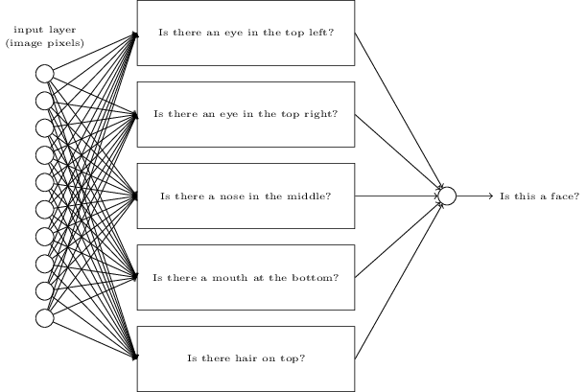
Example: Face Detection

Slide 11
Example: Minimax in Games
Use Cutoff-Test instead of Terminal-Test
e.g., depth limit.
Use Eval instead of Utility
i.e., evaluation function that estimates desirability of position.

Slide 12
Eval in AlphaGo
Black to play:
Percentage of winning if playing at some potential spots.
D Silver et al. Nature 529, 484–489 (2016) doi:10.1038/nature16961

Slide 13
Outline
Introduction
Neural Networks

Slide 14

Neural Network
x₁
f₁
Linear weighted combination
Non-linear activation function
x₂
f₂
f₄
$$=\tilde{y}$$
x₃
f₃
x₄
Linear weighted combination
Non-linear activation function

Slide 15
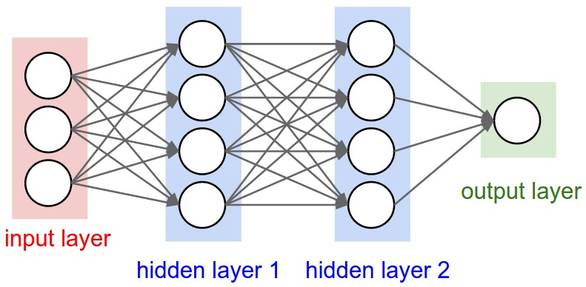
Neural Network (cont’d)
Neurons

Slide 16

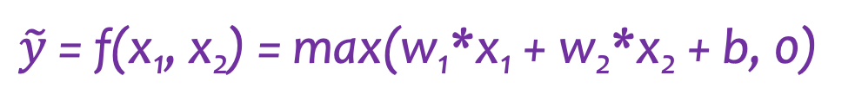
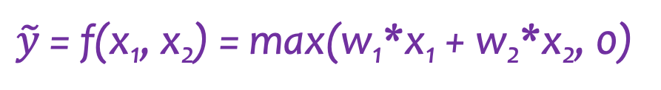
Illustration with a Simple Example
ReLU (Rectified Linear Unit)
a(z) = max(z,0)
x₁
w₁
a
$$\tilde{y}$$
w₂
x₂
b
1
$\tilde{y}$ = f(x₁, x₂) = max(w₁*x₁ + w₂*x₂, 0)
Bias
$\tilde{y}$ = f(x₁, x₂) = max(w₁*x₁ + w₂*x₂ + b, 0)
Notes:
ReLU: if signal <= 0; then do not send any input (aka, send 0); else, send signal to next neural node.
Note, in y = mx + b, b= bias = starting point or origin; the bias must also be learned for neural network.

Slide 17
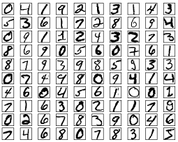
MNIST: Handwritten Digits
28x28=784 pixels for each digit

Slide 18
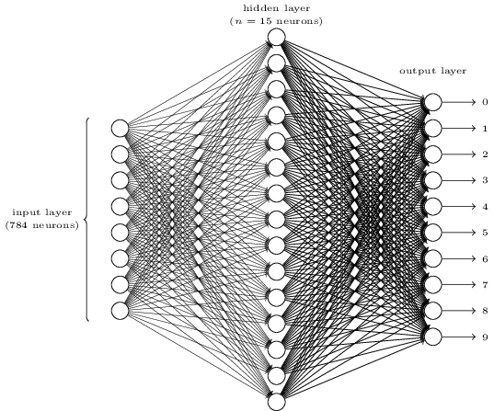
3-Layer Neural Network
Input layer: 28*28 neurons.
Each neuron: a gray-scale value of a pixel

Slide 19
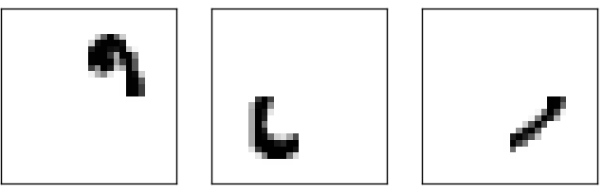
3-Layer Neural Network
Hidden layer: features from input layer

Slide 20
3-Layer Neural Network
6
9
0
0
0
0
0
0
1
0
0
0
0
0
0
0
0
0
0
0
0
1
Output layer: classes
It is represented as a hot vector

Slide 21
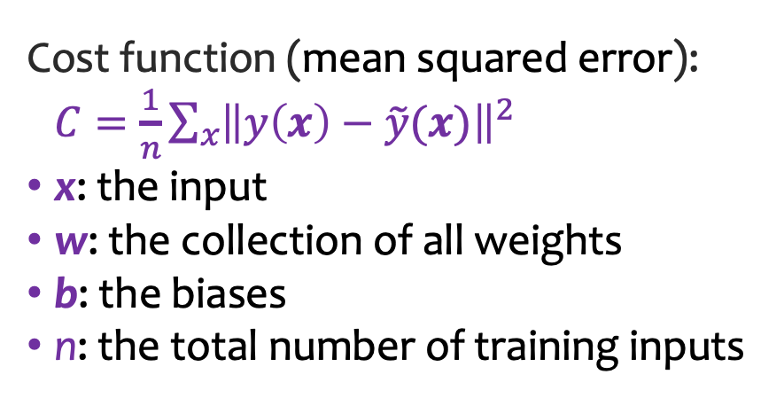
3-Layer Neural Network
Cost function (mean squared error):
$C=\frac{1}{n}\sum_{x}{{\left\|y\left(x\right)−\tilde{y}(x)\right\|}^{2}}$
x: the input
w: the collection of all weights
b: the biases
n: the total number of training inputs
Notes:
Goal: still minimize cost (MSE), but really we want to optimize it because if it is too low = overfitting!

Slide 22
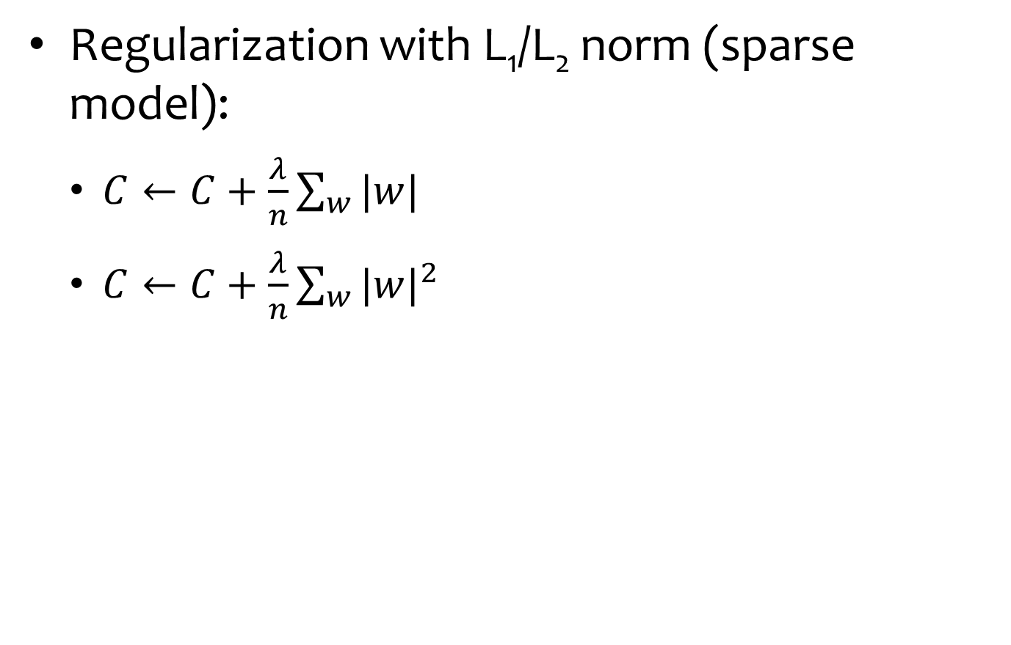
Overfitting Prevention: Regularization
Regularization with L₁/L₂ norm (sparse model):
$C←C+\frac{λ}{n}\sum_{w}{|w|}$
$C←C+\frac{λ}{n}\sum_{w}{{|w|}^{2}}$
Notes:
If your network has a lot of links, but many of them are 0, we can then use sparse model approach and treat the network as if it has less links by ignoring the 0 links (as long as it does not affect performance/accuracy).

Slide 23
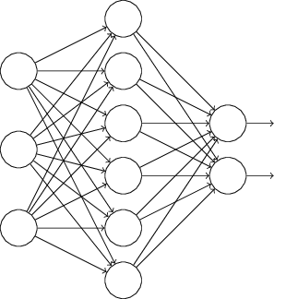
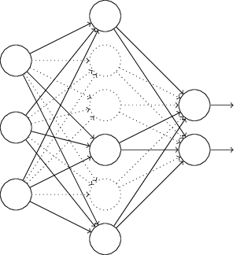
Overfitting Prevention: Dropout
Notes:
Throw out some neurons during training (training data set fed to network) so that we do not over minimize the MSE (minimize cost) and thus overfit.
Remember: when we overfit with the training data, then future data from the real environment will not have as much of an impact/influence on the model and thus the model will become less accurate.

Slide 24
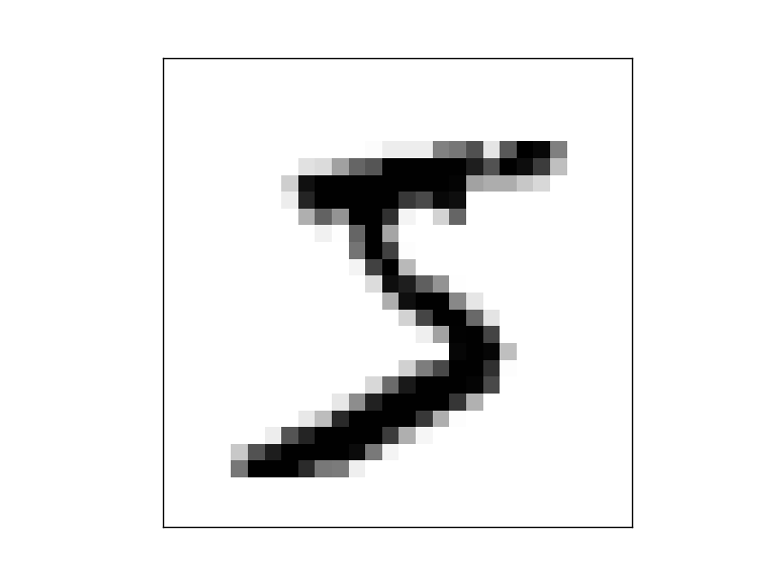
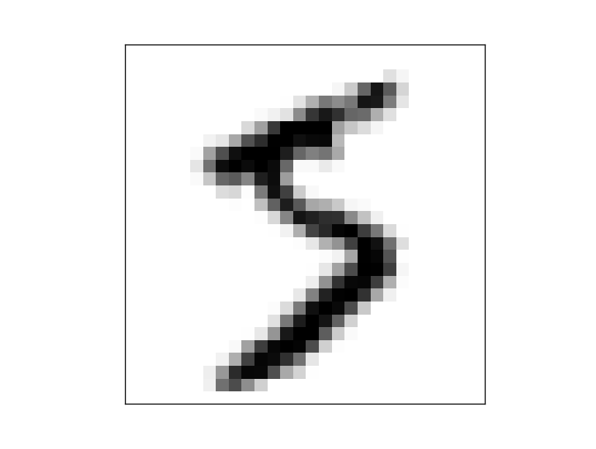
Overfitting Prevention: Artificially Expanding the Training Data
rotate it by 15 degrees = new training data
Notes:
MORE DATA = BETTER: IMPROVES ACCURACY BY PREVENTING OVERFITTING.

Slide 25
Outline
Introduction
Neural Networks
Stochastic Gradient Descent (SGD)

Slide 26
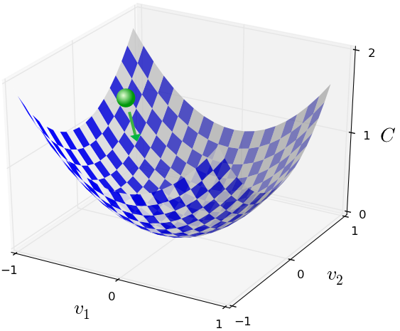
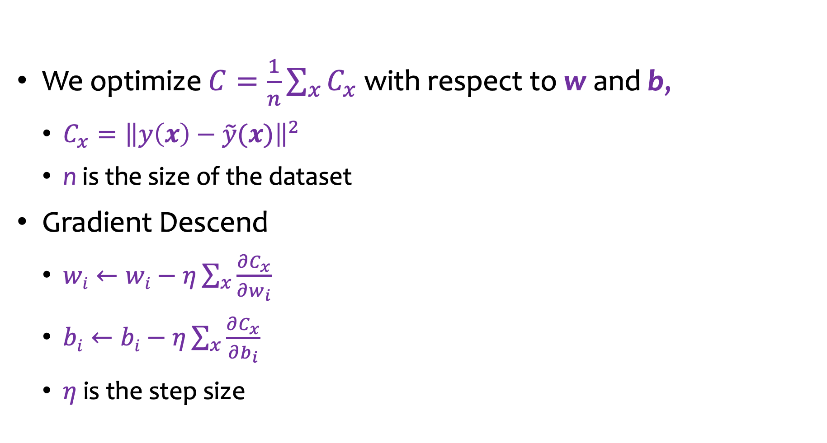
Gradient Descend
We optimize $C=\frac{1}{n}\sum_{x}{C_{x}}$ with respect to w and b,
$C_{x}={\left\|y\left(x\right)−\tilde{y}(x)\right\|}^{2}$
n is the size of the dataset
Gradient Descend
$wi←wi−η\sum_{x}{\frac{∂C_{x}}{∂w_{i}}}$
$bi←bi−η\sum_{x}{\frac{∂C_{x}}{∂b_{i}}}$
$η$ is the step size
Due to the large data set size n, computation is too expensive!
Notes:
For weights w, pick a bias (starting point) randomly.
Remember gradient descent = take derivative of all dimensions separately and move in that direction for each dimension.
C_x is the training data, which can be huge, so we do not want to calculate partial derivative for all dimensions for each data point; so instead we just take batches/portion of the training data (selected randomly) for calculating each step towards the minimized point of the w-dimension vector; this can also help prevent overfitting.

Slide 27
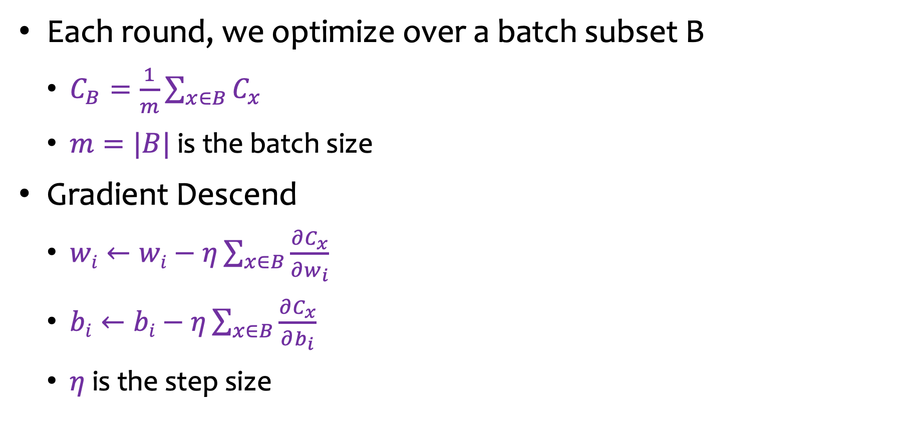
Stochastic Gradient Descend
Each round, we optimize over a batch subset B
$C_{B}=\frac{1}{m}\sum_{x∈B}{C_{x}}$
$m=|B|$ is the batch size
Gradient Descend
$wi←wi−η\sum_{x∈B}{\frac{∂C_{x}}{∂w_{i}}}$
$bi←bi−η\sum_{x∈B}{\frac{∂C_{x}}{∂b_{i}}}$
$η$ is the step size
The batch size m is small, computation is OK!

Slide 28
Comparison
GD
SGD
Contour plot
Notes:
Using stochastic gradient descent by sampling (of the training data) will result in much faster descent and allow to get out of local min at only the cost of more runs (steps); but the extra steps is negligible compared to increased speed.

Slide 29
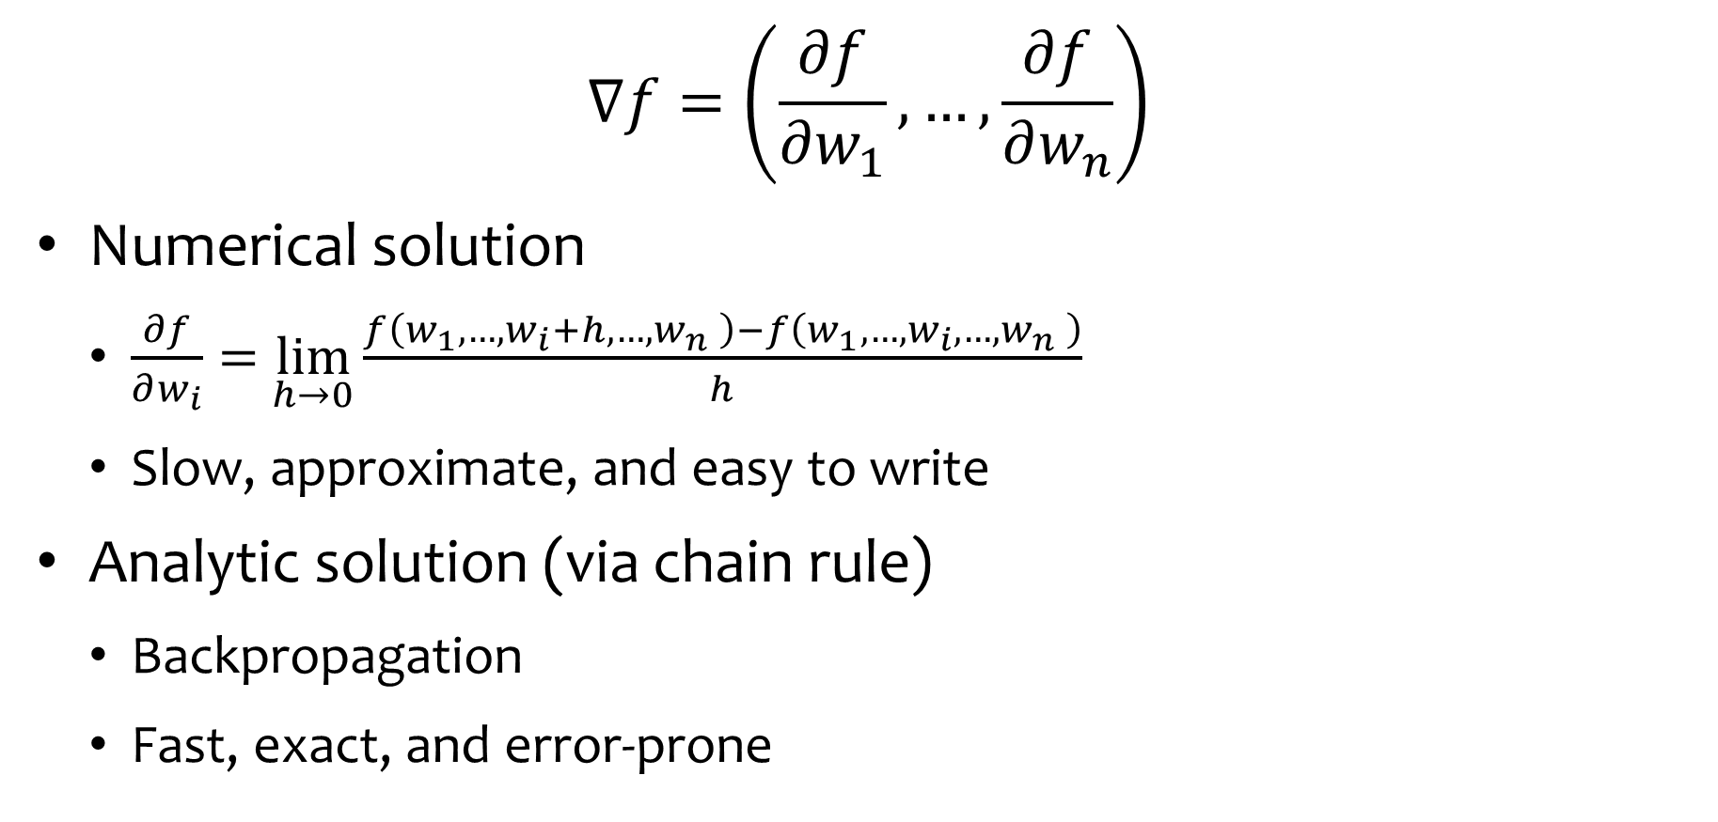
How to Obtain Gradients?
$$∇f=\left(\frac{∂f}{∂w_{1}},…,\frac{∂f}{∂w_{n}}\right)$$
Numerical solution
$\frac{∂f}{∂w_{i}}=$ $\lim_{h→0}\frac{f\left(w_{1},…,w_{i}+h,{…,w}_{n}\right)−f\left(w_{1},…,w_{i},{…,w}_{n}\right)}{h}$
Slow, approximate, and easy to write
Analytic solution (via chain rule)
Backpropagation
Fast, exact, and error-prone
Numerical solution
real solution

Slide 30
Outline
Introduction
Neural Networks
Stochastic Gradient Descent (SGD)
Backpropagation = analytical solution (for optimization of the weights (links) of the neural network); used to implement SGD.

Slide 31

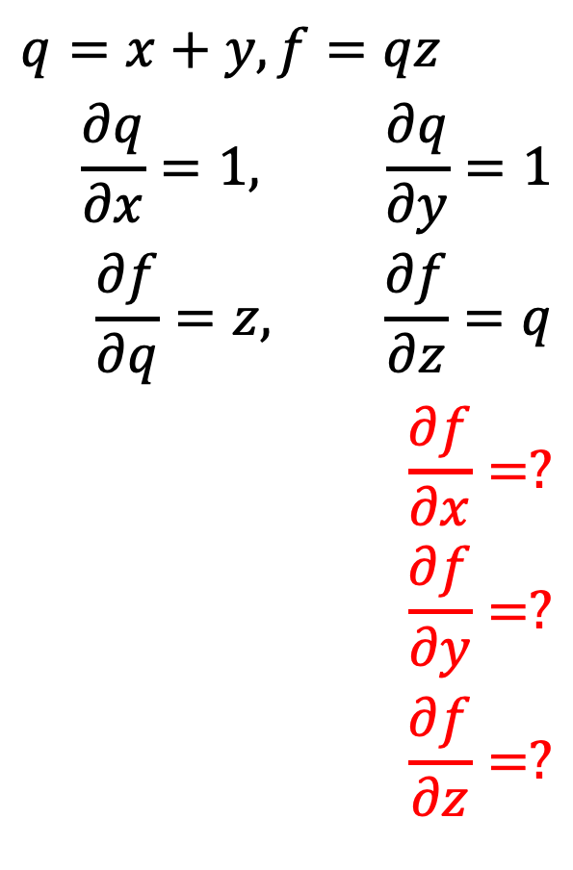

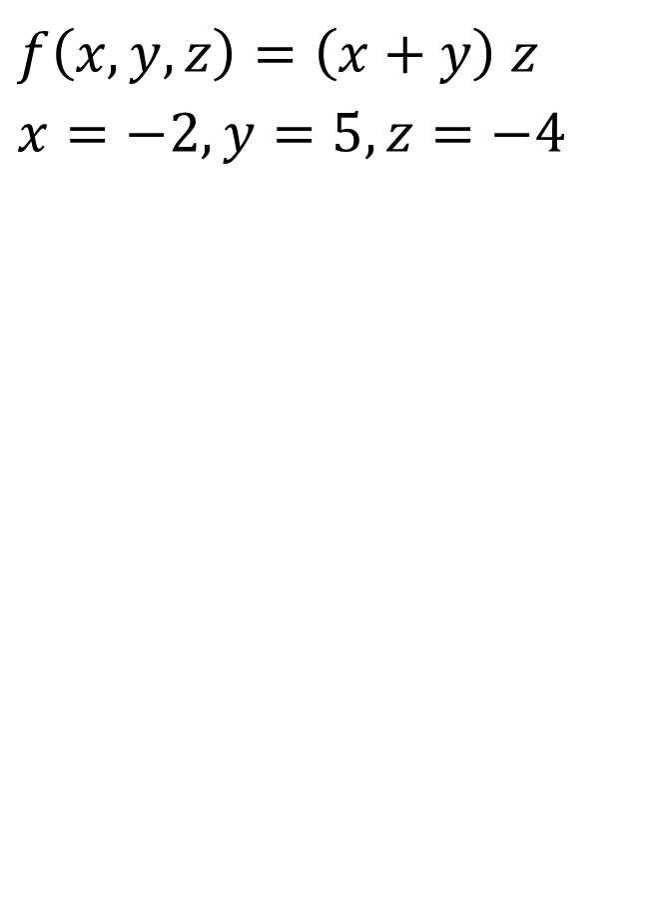
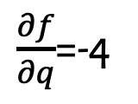

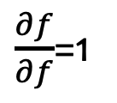
A Simple Example
$$f\left(x,y,z\right)=\left(x+y\right) z$$
$$x=−2, y=5, z=−4$$
$$q=x+y, f=qz$$
$$\frac{∂q}{∂x}=1, \frac{∂q}{∂y}=1$$
$$\frac{∂f}{∂q}=z, \frac{∂f}{∂z}=q$$
$$\frac{∂f}{∂x}=?$$
$$\frac{∂f}{∂y}=?$$
$$\frac{∂f}{∂z}=?$$
x=-2
$\frac{∂f}{∂x}$=$\frac{∂f}{∂q}\frac{∂q}{∂x}$=-4
q: 3
+
$\frac{∂f}{∂q}$=-4
y=5
$\frac{∂f}{∂y}$=$\frac{∂f}{∂q}\frac{∂q}{∂y}$=-4
f=-12
*
$\frac{∂f}{∂f}$=1
z=-4
$\frac{∂f}{∂z}$=3

Slide 32
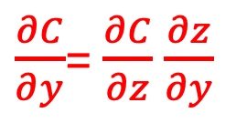

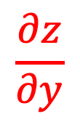

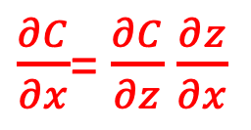
Forward and Back Propagation
x
$\frac{∂C}{∂x}$= $\frac{∂C}{∂z}$ $\frac{∂z}{∂x}$
f(x,y)
$$\frac{∂z}{∂x}$$
z
$$\frac{∂C}{∂z}$$
$$\frac{∂z}{∂y}$$
y
$\frac{∂C}{∂y}$= $\frac{∂C}{∂z}$ $\frac{∂z}{∂y}$

Slide 33
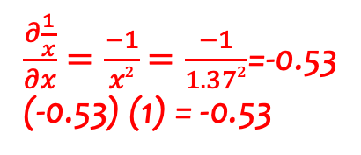
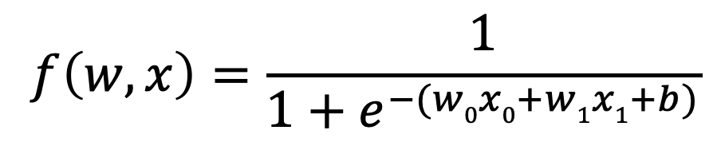
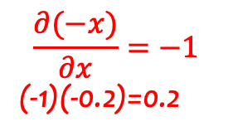
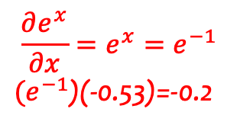
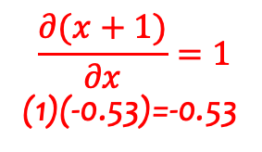
Another Example
(-1)(0.2)=-0.2
$$f\left(w,x\right)=\frac{1}{1+e^{−(w0x0+w1x1+b)}}$$
w₀: 2
-0.2
(1)(0.2)=0.2
*
-2
x₀: -1
0.2
(1)(0.2)=0.2
+
4
$$\frac{∂(x+1)}{∂x}=1$$
(1)(-0.53)=-0.53
(-2)(0.2)=-0.4
$$\frac{∂(−x)}{∂x}=−1$$
(-1)(-0.2)=0.2
w₁: -3
0.2
-0.4
*
6
1
-1
0.37
1.37
0.73
+
-1*
exp
+1
1/
0.2
0.2
-0.2
-0.53
-0.53
1
x₁: -2
(1)(0.2)=0.2
$\frac{∂\frac{1}{x}}{∂x}=\frac{−1}{x2}$ $=\frac{−1}{1.372}$=-0.53
(-0.53) (1) = -0.53
$$\frac{∂e^{x}}{∂x}=e^{x}=e^{−1}$$
${(e}^{−1}$)(-0.53)=-0.2
b: -3
0.2
(1)(0.2)=0.2
Notes:
We aim to optimize 3 parameters (selected with initial random values, which are not optimal): w0, w1, and b (bias).
X1 and X2 is the training data (given).
In this example, we first do forward propagation, then backward propagation, which results in optimizing the desired parameters (w0,w1,b).

Slide 34
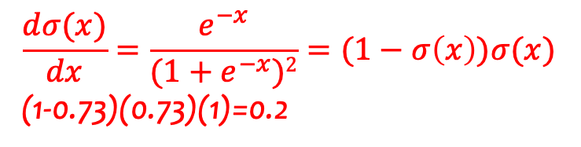
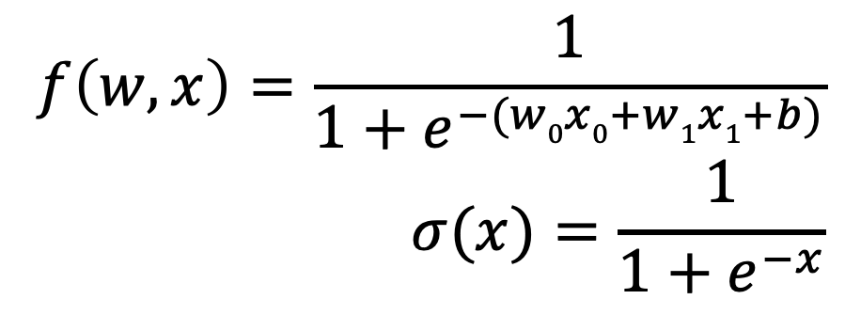
Sigmoid Function
$$f\left(w,x\right)=\frac{1}{{1+e}^{−(w0x0+w1x1+b)}}$$
$$σ(x)=\frac{1}{{1+e}^{−x}}$$
w₀: 2
-0.2
*
-2
x₀: -1
0.2
+
4
w₁: -3
0.2
sigmoid gate
-0.4
*
6
1
-1
0.37
1.37
0.73
+
-1*
exp
+1
1/
0.2
0.2
-0.2
-0.53
-0.53
1
x₁: -2
$$\frac{dσ(x)}{dx}=\frac{e^{−x}}{{(1+e}^{−x})2}=(1−σ\left(x\right))σ(x)$$
(1-0.73)(0.73)(1)=0.2
b: -3
0.2

Slide 35
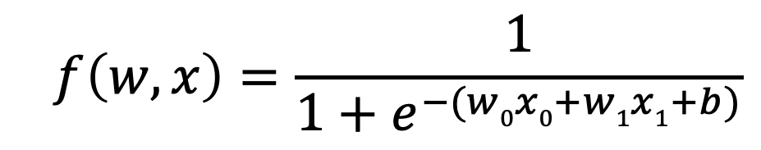
Exercise
$$f\left(w,x\right)=\frac{1}{1+e^{−(w0x0+w1x1+b)}}$$
w₀: -2
-0.2
*
?
x₀: 2
?
+
?
w₁: 3
?
?
*
?
?
?
?
?
?
+
-1*
exp
+1
1/
?
?
?
?
?
?
x₁: -1
b: 6
?

Slide 36
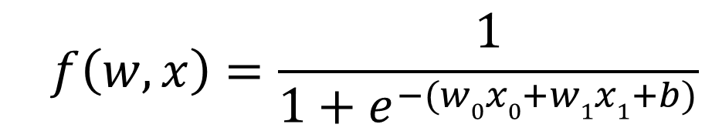
Exercise
$$f\left(w,x\right)=\frac{1}{1+e^{−(w0x0+w1x1+b)}}$$
w₀: -2
-0.2
*
?
x₀: 2
?
+
?
w₁: 3
?
?
*
?
?
?
?
?
?
+
-1*
exp
+1
1/
?
?
?
?
?
?
x₁: -1
b: 6
?

Slide 37
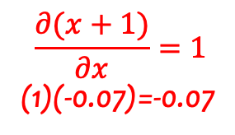
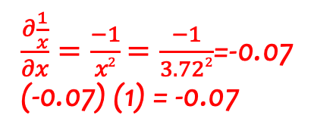
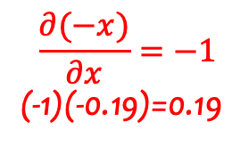
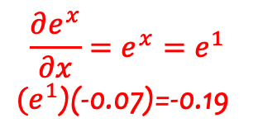
Solution
(2)(0.19)=0.38
$$f\left(w,x\right)=\frac{1}{1+e^{−(w0x0+w1x1+b)}}$$
w₀: -2
0.38
(1)(0.19)=0.19
*
-4
x₀: 2
0.19
(1)(0.19)=0.19
+
-7
$$\frac{∂(x+1)}{∂x}=1$$
(1)(-0.07)=-0.07
(-1)(0.19)=-0.19
$$\frac{∂(−x)}{∂x}=−1$$
(-1)(-0.19)=0.19
w₁: 3
0.19
-0.19
*
-3
-1
1
2.72
3.72
0.27
+
-1*
exp
+1
1/
0.19
0.19
-0.19
-0.07
-0.07
1
x₁: -1
(1)(0.19)=0.19
$$\frac{∂e^{x}}{∂x}=e^{x}=e^{1}$$
${(e}^{1}$)(-0.07)=-0.19
$\frac{∂\frac{1}{x}}{∂x}=\frac{−1}{x2}$ $=\frac{−1}{3.722}$=-0.07
(-0.07) (1) = -0.07
b: 6
0.19
(1)(0.19)=0.19

Slide 38
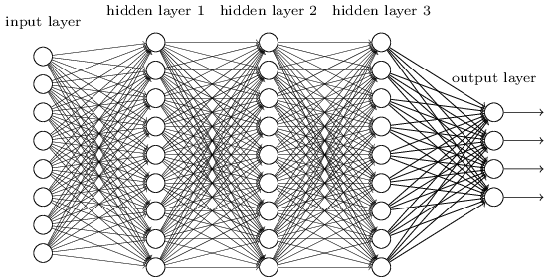
Trade-Off in Neural Network Design
More neurons, more width/depth
more powerful/general function
harder to learn
Many neurons with some constraints:
Such as Convolutional Neural Network (CNN)

Slide 39
Outline
Introduction
Neural Networks
Stochastic Gradient Descent (SGD)
Backpropagation
Convolutional Neural Network (CNN)

Slide 40
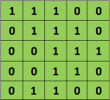

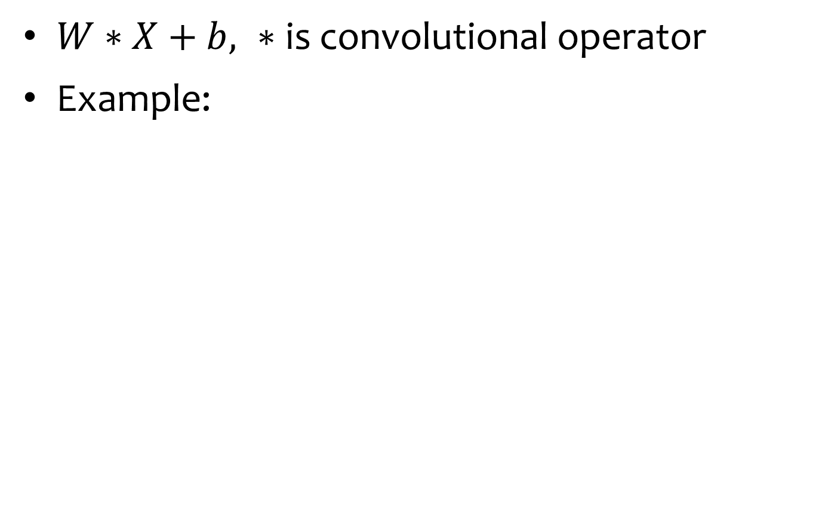
Convolution
$W∗X+b, ∗$ is convolutional operator
Example:
Input X
Filter W
Bias b=0
https://ujjwalkarn.me/2016/08/11/intuitive-explanation-convnets

Slide 41
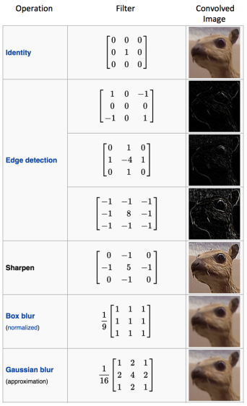
Some Filters
https://ujjwalkarn.me/2016/08/11/intuitive-explanation-convnets

Slide 42
Exercise: Edge Detection
1 | 0 | 1 | 1 | 0
1 | 0 | 0 | 1 | 1
0 | 1 | 0 | 1 | 0
0 | 0 | 1 | 0 | 1
1 | 0 | 1 | 1 | 0
1 | 0 | -1
0 | 0 | 0
-1 | 0 | 1
Input X
Filter W
Bias b=0
Convoluted feature

Slide 43
Solution: Edge Detection
1 | 0 | 1 | 1 | 0
1 | 0 | 0 | 1 | 1
0 | 1 | 0 | 1 | 0
0 | 0 | 1 | 0 | 1
1 | 0 | 1 | 1 | 0
1 | 0 | -1
0 | 0 | 0
-1 | 0 | 1
Input X
Filter W
Bias b=0
0 | -1 | 1
2 | -1 | -1
0 | 1 | -1
Convoluted feature

Slide 44
Convolutional Neural Network (CNN)
CNN use three basic ideas:
Local receptive fields
Shared weights and biases
Pooling

Slide 45
Outline
Introduction
Neural Networks
Stochastic Gradient Descent (SGD)
Backpropagation
Convolutional Neural Network (CNN)
Local Receptive Fields

Slide 46
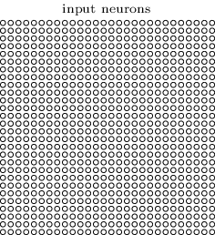
Input Neurons for MNIST
28x28

Slide 47
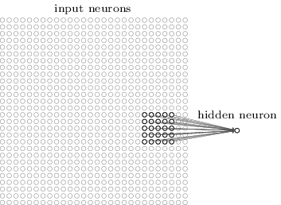
From Input to 1st Hidden Layer
But we won't connect every input pixel to every hidden neuron.
Instead, we only make connections in small, localized regions of the input image.
That region in the input image is called the local receptive field for the hidden neuron.
5x5 -> 1

Slide 48
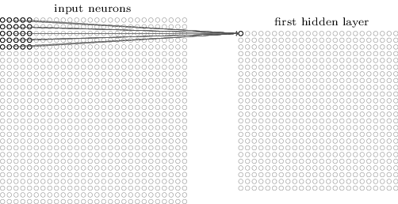
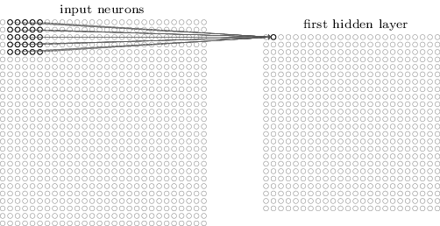
Sliding the Local Receptive Field
28x28
24x24

Slide 49
Stride Length
Local receptive field can be moved by more than one pixel at a time.
For instance, we might move the local receptive field 2 pixels to the right (or down), in which case we'd say a stride length of 2 is used.

Slide 50
Outline
Introduction
Neural Networks
Stochastic Gradient Descent (SGD)
Backpropagation
Convolutional Neural Network (CNN)
Local Receptive Fields
Shared Weights and Biases

Slide 51
Shared Weights and Biases
Use the same
5x5 weight matrix
+
1 bias

Slide 52
Interpretation
This means that all the neurons in the first hidden layer detect exactly the same feature (e.g., a vertical edge), just at different locations in the input image.
To put it in slightly more abstract terms, CNNs are well adapted to the translation invariance of images: move a vertical line (say) a little ways, and it's still an image of a a vertical line.

Slide 53
Feature Map
We sometimes call the map from the input layer to the hidden layer a feature map.
We call the weights defining the feature map the shared weights. And we call the bias defining the feature map in this way the shared bias.
The shared weights and bias are often said to define a kernel or filter.

Slide 54

More Feature Maps
Example:
1 vertical line
1 horizontal line
1 circle

Slide 55

Feature Maps for MNIST
Many of the features have clear sub-regions of light and dark.
That shows our network really is learning things related to the spatial structure.
20 5x5 feature maps:
Whiter blocks mean a smaller (typically, more negative) weight, so the feature map responds less to corresponding input pixels.
Darker blocks mean a larger weight.

Slide 56
Reduced Number of Parameters
CNN for 20 features:
(5x5+1) x 20 = 520
Fully connected with 20 hidden neurons
(28x28) x 20 + 20 = 15,700

Slide 57
Outline
Introduction
Neural Networks
Stochastic Gradient Descent (SGD)
Backpropagation
Convolutional Neural Network (CNN)
Local Receptive Fields
Shared Weights and Biases
Pooling

Slide 58
Pooling Layer
In addition to the convolutional layers just described, convolutional neural networks also contain pooling layers.
Pooling layers are usually used immediately after convolutional layers.

Slide 59

Pooling: Condensing Feature Map
12x12
24x24
In max-pooling, a pooling unit simply outputs the maximum activation in the 2×2 input region.

Slide 60

A Three-Layer CNN

Slide 61
Interpretation
We can think of max-pooling as a way for the network to ask whether a given feature is found anywhere in a region of the image.
It then throws away the exact positional information.
The intuition is that once a feature has been found, its exact location isn't as important as its rough location relative to other features.
A big benefit is that there are many fewer pooled features, and so this helps reduce the number of parameters needed in later layers.

Slide 62
L2 Pooling
Here, instead of taking the maximum activation of a 2×2 region of neurons, we take the square root of the sum of the squares of the activations in the 2×2 region.
While the details are different, the intuition is similar to max-pooling: L2 pooling is a way of condensing information from the convolutional layer.

Slide 63

Putting All Together
The final layer of connections in the network is a fully-connected layer, i.e., this layer connects every neuron from the max-pooled layer to every one of the 10 output neurons.

Slide 64
Demo
https://cs.stanford.edu/people/karpathy/convnetjs/demo/cifar10.html

Slide 65
Outline
Introduction
Neural Networks
Stochastic Gradient Descent (SGD)
Backpropagation
Convolutional Neural Network (CNN)
Recurrent Neural Network (RNN)

Slide 66
Examples of Sequence Data
Speech recognition
Music generation
Sentiment classification
DNA sequence analysis
Machine translation
Video activity recognition

Slide 67

RNN Models

Slide 68

An Example
W_{hy}
W_{hh}
h_{i} = tanh(W_{hh}*h_{i-1} + W_{xh}*x_{i})
y_{i} = W_{hy} *h_{i}
W_{xh}
Notes:
x = input char
Called “recurrent” neural network because you have to use the output from the previous steps during calculations; such as the previous letter affects prediction for the next letter to form some word.

Slide 69
SPECIAL NOTE ON REGRESSION AND OVER/UNDER FITTING
GOAL OF ANY REGRESSION: FIND A MODEL (LINE) WITH THE SMALLEST MSE (MEAN SQUARE ERROR) WHILE NOT OVERFITTING (MSE cannot be too close to 0).
-If MSE is too high = underfitting!
-if MSE is too low = overfitting!

